Slide 1
Volvo Truck Analytics
Ioannis Batsios, William Downs, Wahab Ehsan, James Polk, and Chris T.

Slide 2

General Overview
Christopher: Truck 2 GPS Speed Corrections
Wahab: Time for Ideal Temperature Depending on Outside Temperature
Ioannis: External Temperature Effects on Engine Components
James: Time Series Analysis on CPU and Related Components
Bill: APU Predictions by Regression

Slide 3
“Correcting” Truck 2’s GPS Speed Values
Truck 2 has faulty GPS Speed data.
The component was clearly reading much lower than its Wheel-Based Speed counterpart.
Its faulty values are proven by the consistency in Truck 1’s data with the same components.
Misconfigured?
Different units?
Broken component?
Goal:
Use the data and trends of Truck 1 to help predict, or correct, GPS Speed values for Truck 2.
Note: this was an analytical task, NOT a machine learning task.

Slide 4
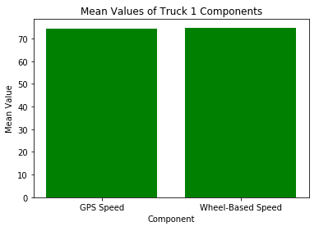
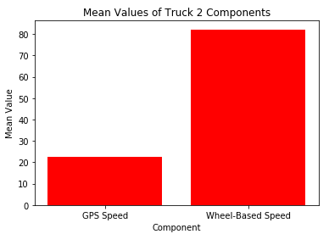
The Data at Hand
Recall the data for both trucks.
Like Truck 1’s data, Truck 2’s values should have been relatively identical.

Slide 5
The Analytical Solution
Since Truck 1 had “better” data than Truck 2:
Utilize Truck 1’s data to “predict” or “correct” Truck 2’s GPS Speed.
Given any Wheel-Based Speed value for Truck 2.
Implementation:
Calculate mean difference of GPS Speed and Wheel-Based Speed for Truck 1.
-0.28539807628549124 (GPS - Wheel).
Indicates that GPS is reading slightly lower than Wheel-Based.
Iterate through Truck 2’s Wheel-Based Speed data.
Add the difference of means to each one and store the result in a new column.

Slide 6
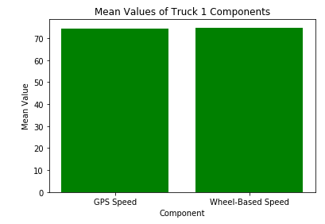
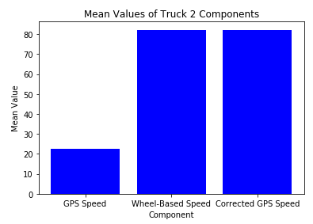


Resulting Data

Slide 7
Time to Get to the Ideal Temperature
Time for Engine Oil Temperature to get to ‘Ideal Temperature’ based on the Outside Temperature.
Ideal Temperature as Average temperature of oil.
Outside Temperature as Average Temperature for the day.
Supervised approach with Linear Regression.

Slide 8
Problems and Possible Solutions
Time from start of truck to ‘ideal temperature’.
Split data into when trucks started and when finished ‘session’.
Truck 2 data was majority already ‘started and running’ data.
Not all data available was from start of truck ‘session’.
There were 45 ‘sessions’ but only 7 valid ones with enough temperature difference between start to ‘ideal’ and long enough ‘session’.

Slide 9
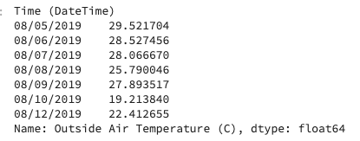
Problems and Possible Solutions (cont.)
Made function to find time between rows.
Found average oil temperature for each ‘session’ for ideal temperature.
Filtered and ignored data with sessions less than 300 seconds and temperature difference of less than 30 degrees C.
Was able to find average outside temperature using divide by day function.

Slide 10
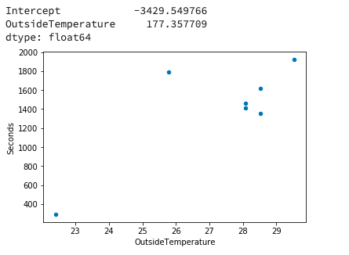
Findings
Using the function, Seconds took till ideal temp ~ Outside Temperature, I was able to find out the following:
Interesting correlation between the variables.
Not as expected, Took longer when warmer Temperature.

Slide 11
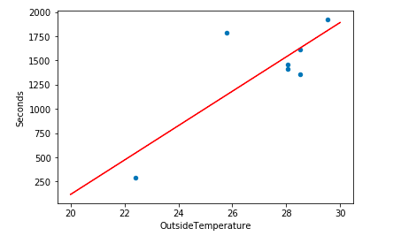

Prediction using Linear Regression
Using statsmodels, was able to figure out the coefficients.
Seconds = (177.3577 * Outside Temperature) - 3429.54977
Using 20 degrees, 25 degrees, 30 degrees Celsius, was able to get the following predictions:
Plot of Least Square Line =
Maybe truck already uses system to check outside temperature and heats up oil if colder weather?
20° C
25° C
30° C

Slide 12
Problem?
Is there a way to determine whether an engine part could be degrading based on its temperature or that of the temperature of other parts?
Solution:
Build a multiple linear regression model to determine what values are expected.

Slide 13

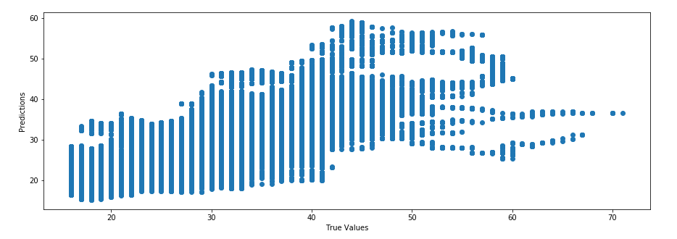
After making a model

Slide 14
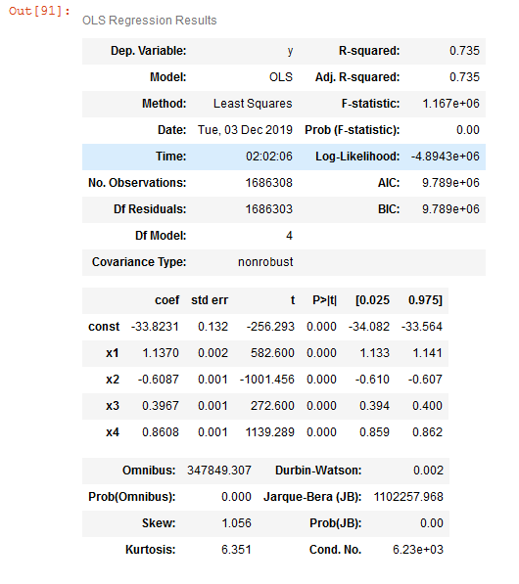
Improving the model
Using Backward Elimination
P-values too small.

Slide 15
Time Series Analysis
Performed Time Series Analysis on CPU Load, Vehicle Weight, Driver Requested Torque, Outside Air Temperature, and Temperature of Air Entering Vehicle.
Problem:
Data is spotty with frequent gaps. Furthermore, data is sampled every 100 milliseconds, causing noise.

Slide 16
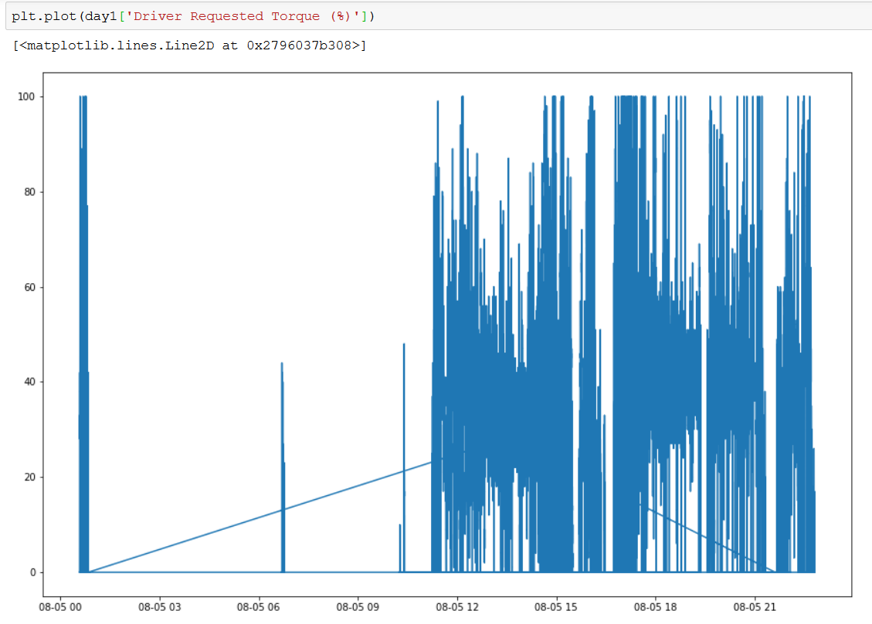
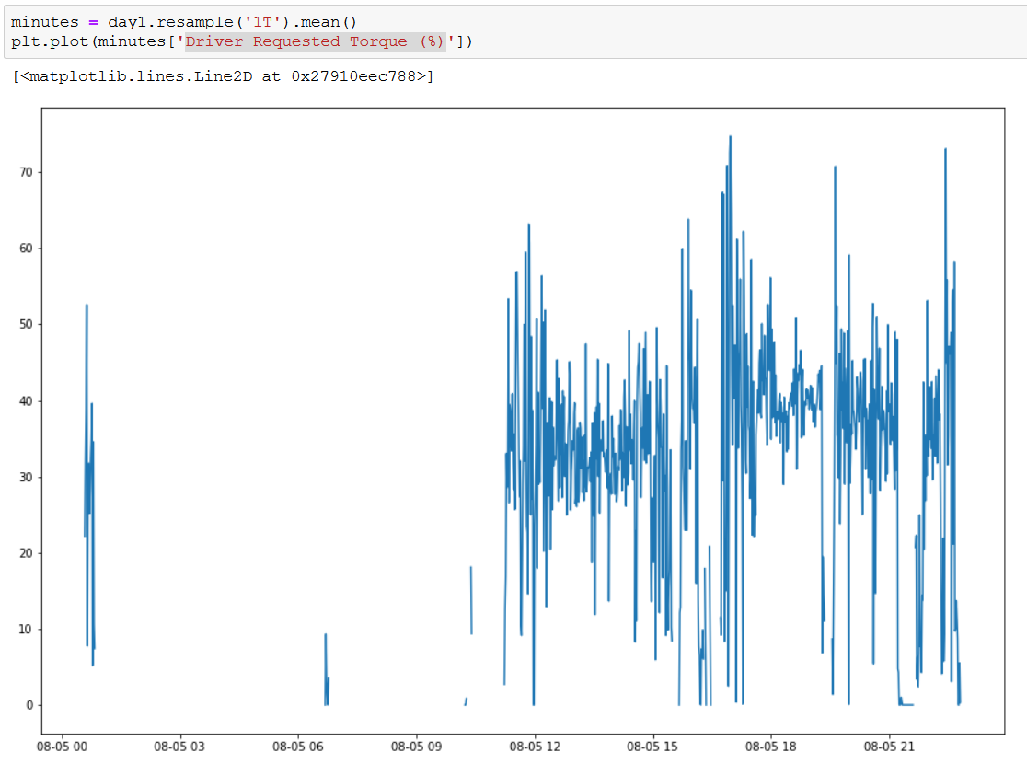
Attempted Solution
Resample data to every minute using mean.
Still frequent dropouts.

Slide 17
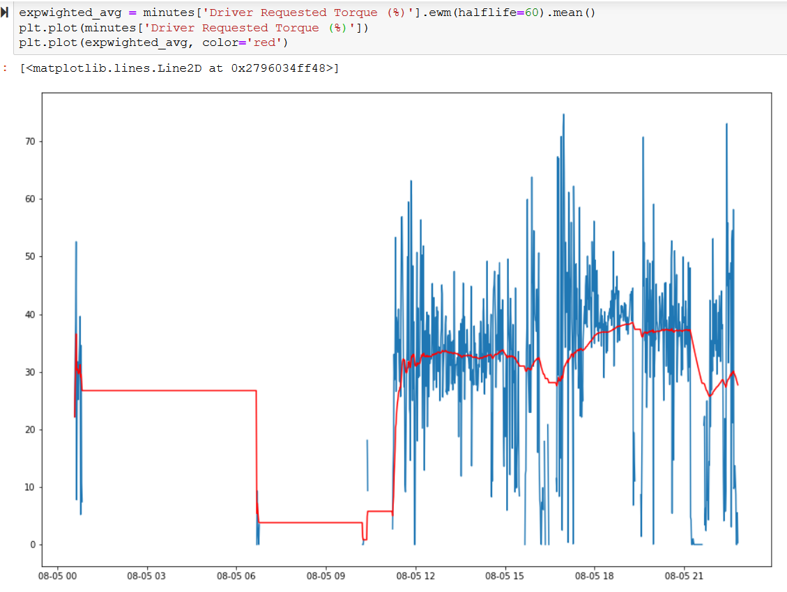
Driver Requested Torque

Slide 18
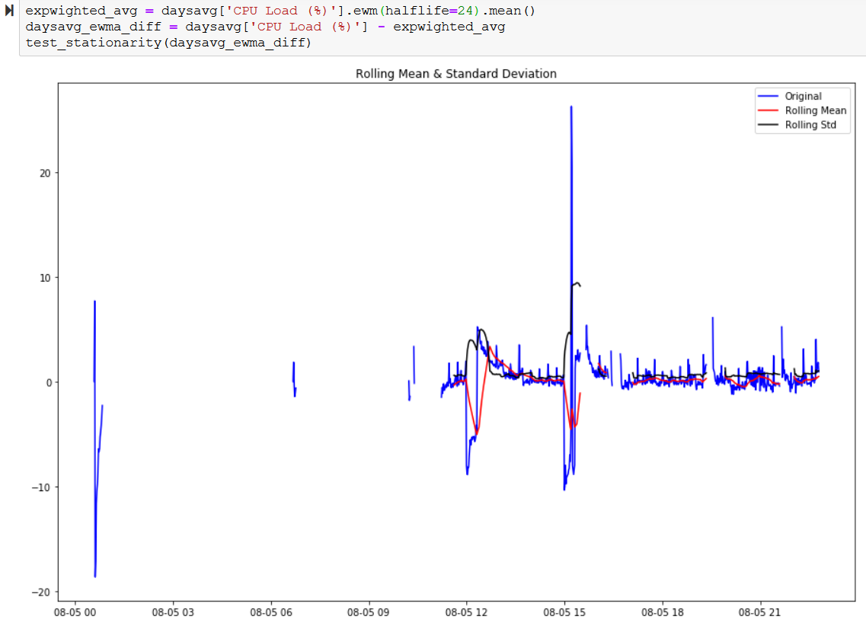
CPU Load

Slide 19
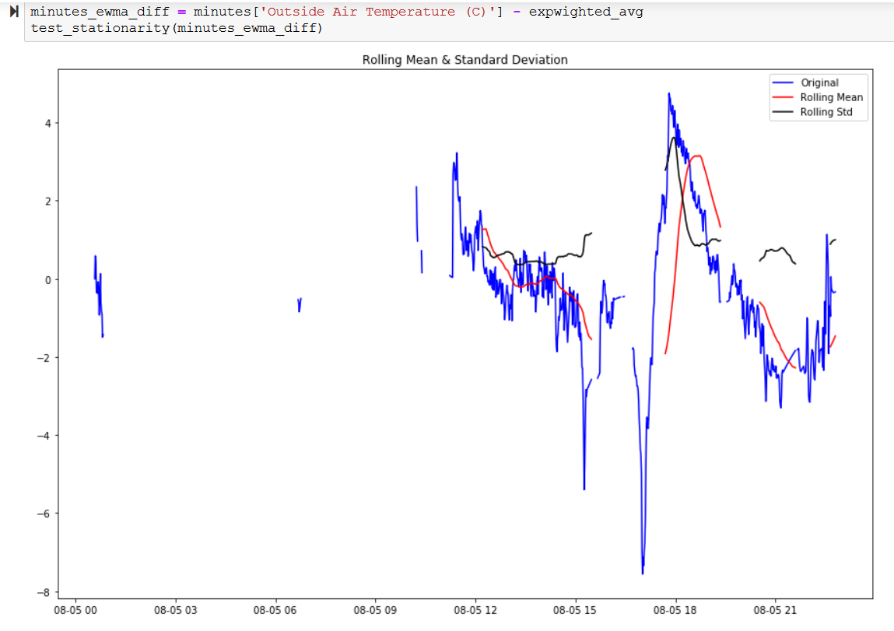
Outside Air Temperature

Slide 20
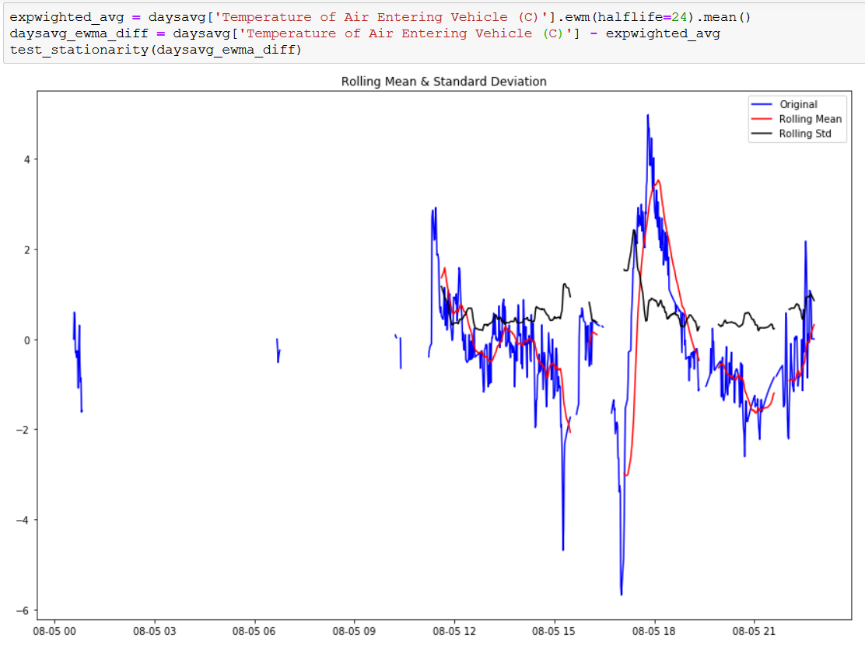
Temp. of Air Entering Vehicle

Slide 21
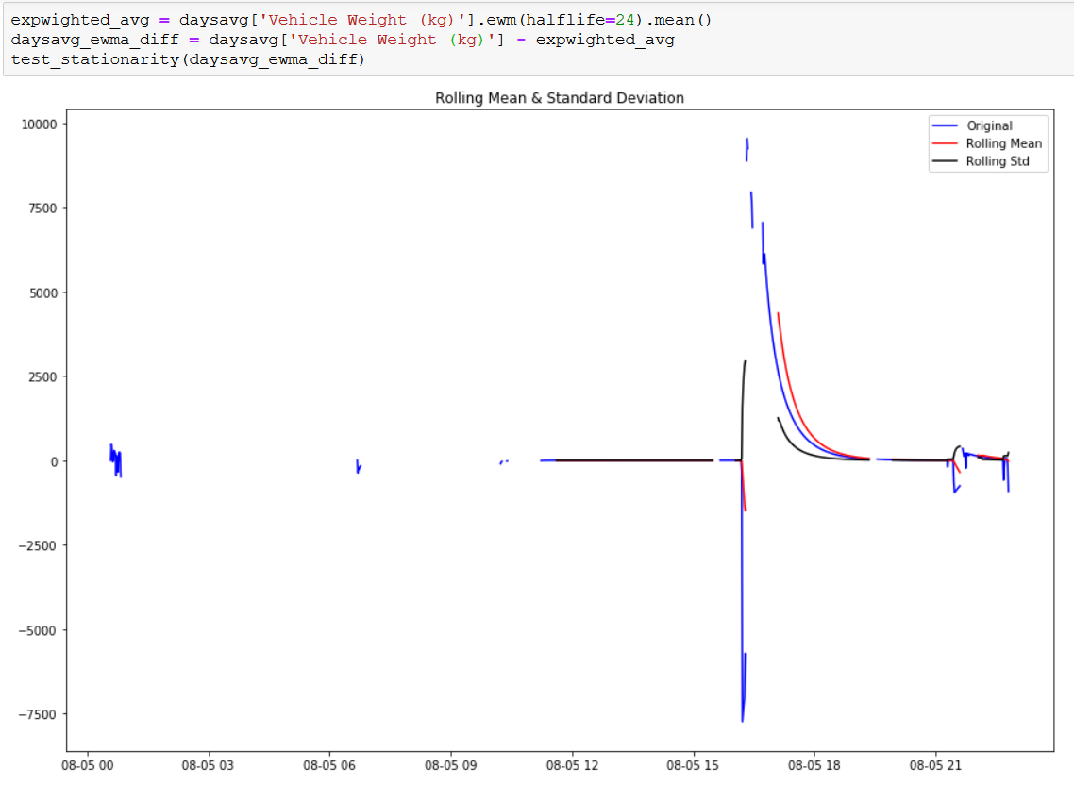
Vehicle Weight

Slide 22
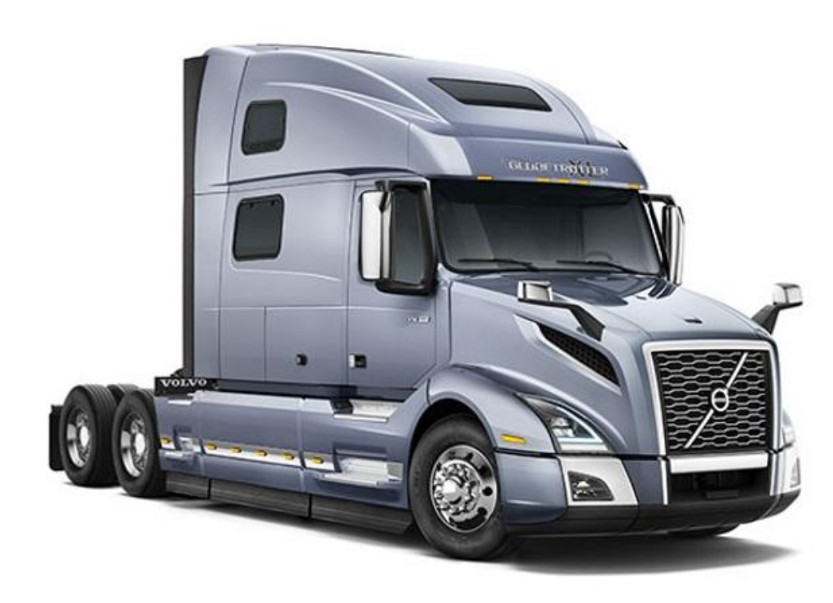


Bill Downs: APU prediction
+
=
Maybe…...

Slide 23
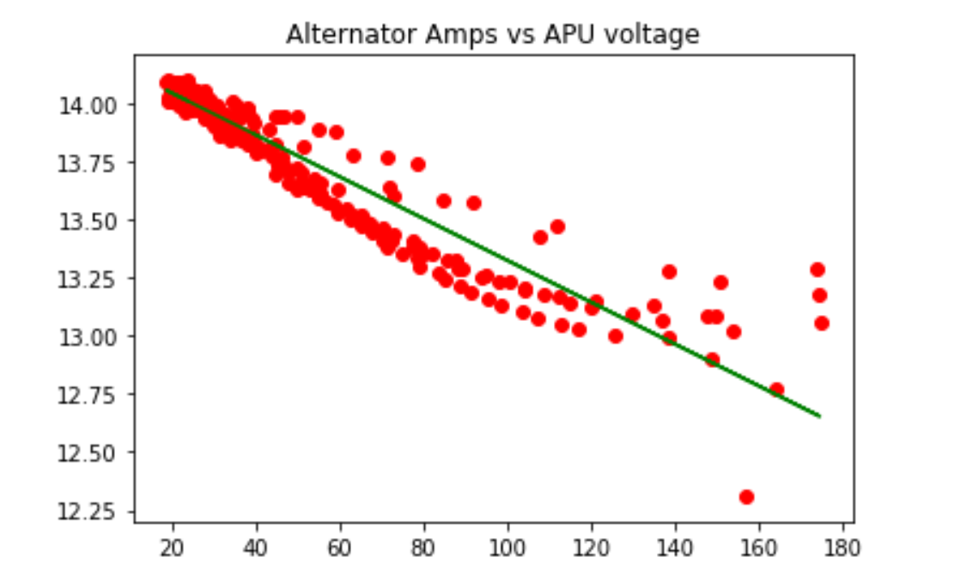
Recall proj 2 APU
This data is related. We can use if for our model.

Slide 24
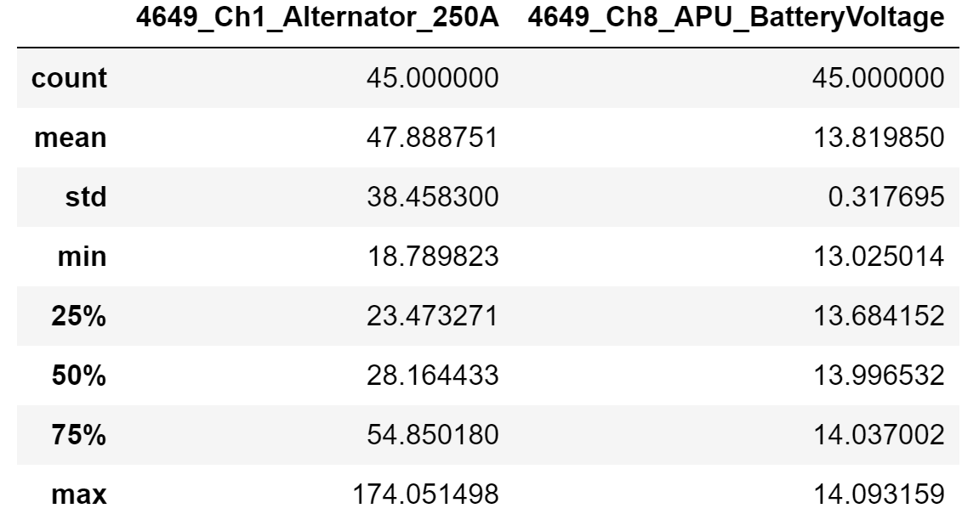
Idea - Binary classification
How- Logistic Regression
First I needed to add a binary column to my data.
Using my dataframe from last project cleaned the data removing any unwanted columns, which left me with the Time, APU, and alternator data.
The APU data was used to calculate a new column where if the voltage was above 14 then 1 else 0. The Volvo electrical engineers were fine with greater than 14 as charged value.
The data was resampled to every 300S for better insight of results. *The 10hz measurement wasnt good for my model.

Slide 25
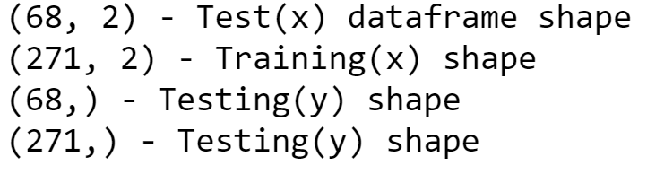
Classifier: Logistic regression
Why? The APU/ and Alternator data had very little outliers as theses are real time monitoring systems connected somehow to a smart switch. i.e...Lead acid batteries can explode if overcharged.
I resampled the data at 300 second and by 3000 to see the results, to maybe better understand my results. At 3000 seconds there were only 14 values in my testing set. So went with 300 which had more values at 68(20%). Which left 80% to my training. Tried a lot of different values here.

Slide 26
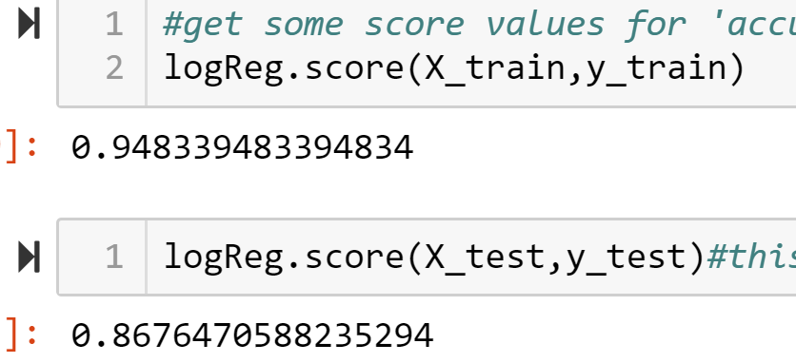
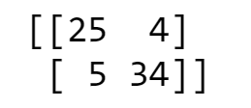
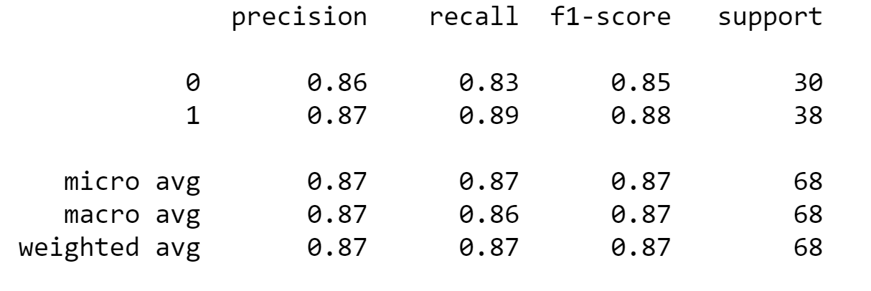
Scores. Confusion matrix. Precision Recall.
Training: 0.94
Testing: 0.86
I liked these values because with the 10Hz data there was a lot of variation from 1 on both testing and training, to low training and high testing….
C.Matrix P&R

Slide 27
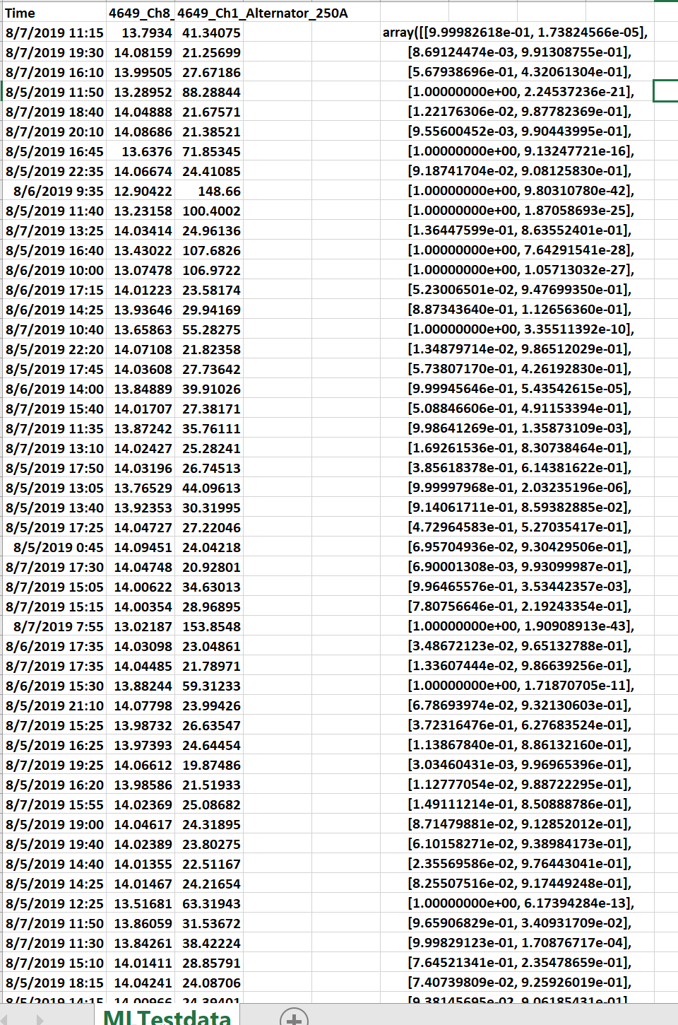
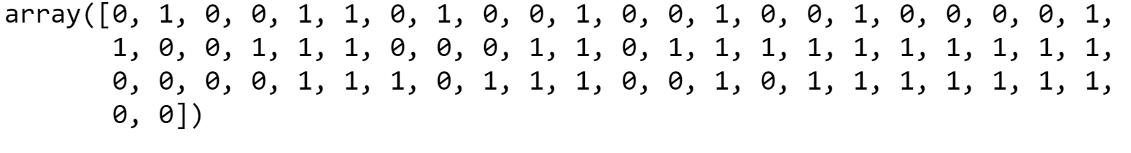
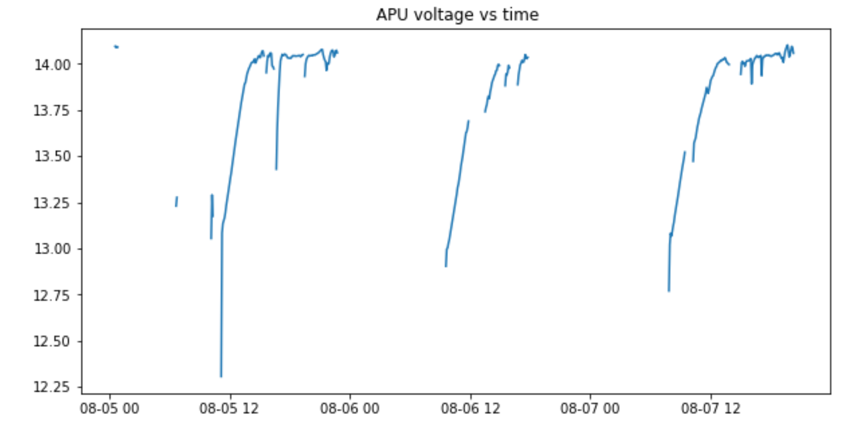
Prediction
But is it believable?? Maybe. More data is probably needed.

Slide 28
APU binary classification conclusion
Low volume data, as i sampled may not be enough. But questions are there now to look into.
Driver habits?
APUs performance for a particular driver?
Fleet driver-break policies?

